Slide 1
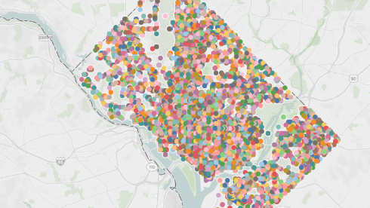
Path of least Violations

Slide 2
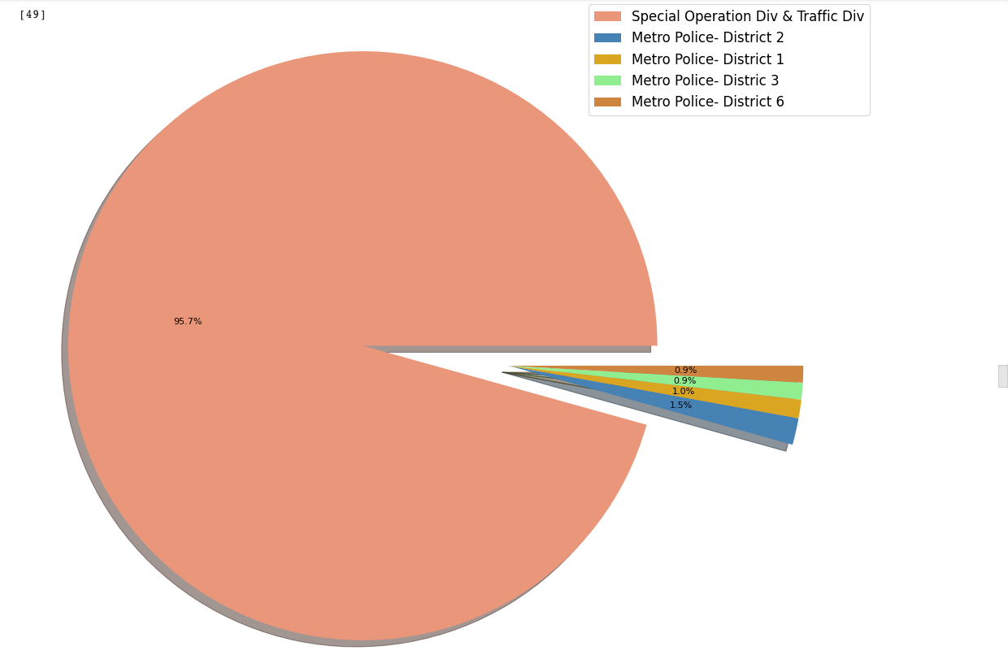
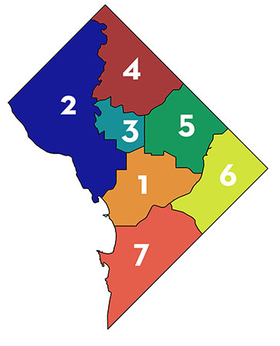
WHICH AGENCY ISSUES THE MOST VIOLATIONS?
Notes:
Special Operations Division and Traffic Division issued the most violations while facilities management issued the least violations.
The Special Operations and Traffic Division issued 1,172, 024 violations in 2019 (approx. 3211 per day), while the next closest agency issued 16, 260
Traffic violations are the most common types of violations

Slide 3
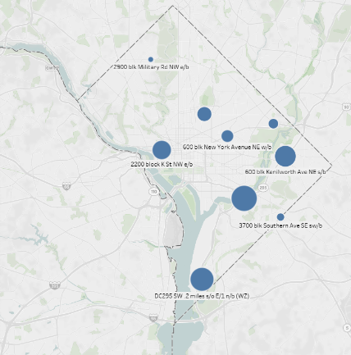
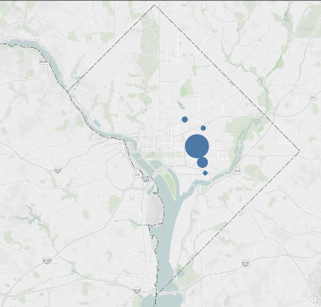
ARE MORE VIOLATIONS ISSUED IN A PARTICULAR AREA OF THE CITY?
Failure to stop per regulations facing red signals
Passing stop sign w/out coming to a full stop
Speed 16-20 MPH over the speed limit
Speed 11-15 MPH over the speed limit
Speed 21-25 MPH over the speed limit
Areas where the most violations were issued
Top 5 violations issued
Notes:
Areas:
DC 295 .2 miles s/o E/1 n/b
600 blk Kenilworth Ave NE s/b
2200 block K St NW e/b
600 blk New York Avenue NE w/b
3700 blk Southern Ave SE sw/b
2900 blk Military Rd NW e/b

Slide 4
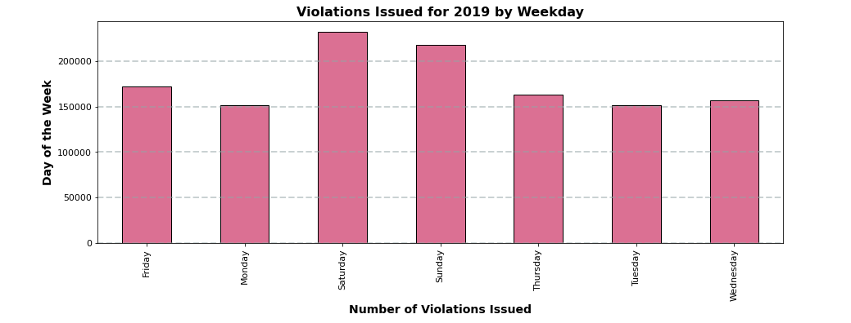
VIOLATIONS BY DAY OF THE WEEK
Notes:
When the data for the entire year was combined, Monday and Tuesday were the days of the week with the least violations while Saturday was the day of the week with the highest number of violations
Violations on a Saturday: 232,162
Monday: 151,199

Slide 5
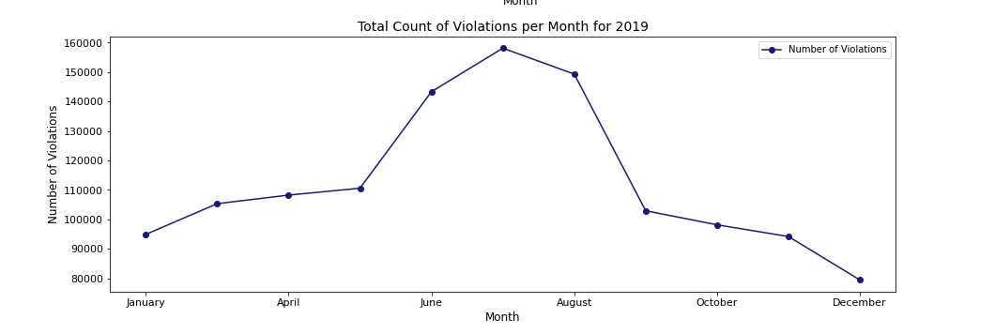
VIOLATIONS BY MONTH
Notes:
Highest number of violations occurred in July, and lowest occurred in December
July: 158,123
December: 79,439

Slide 6
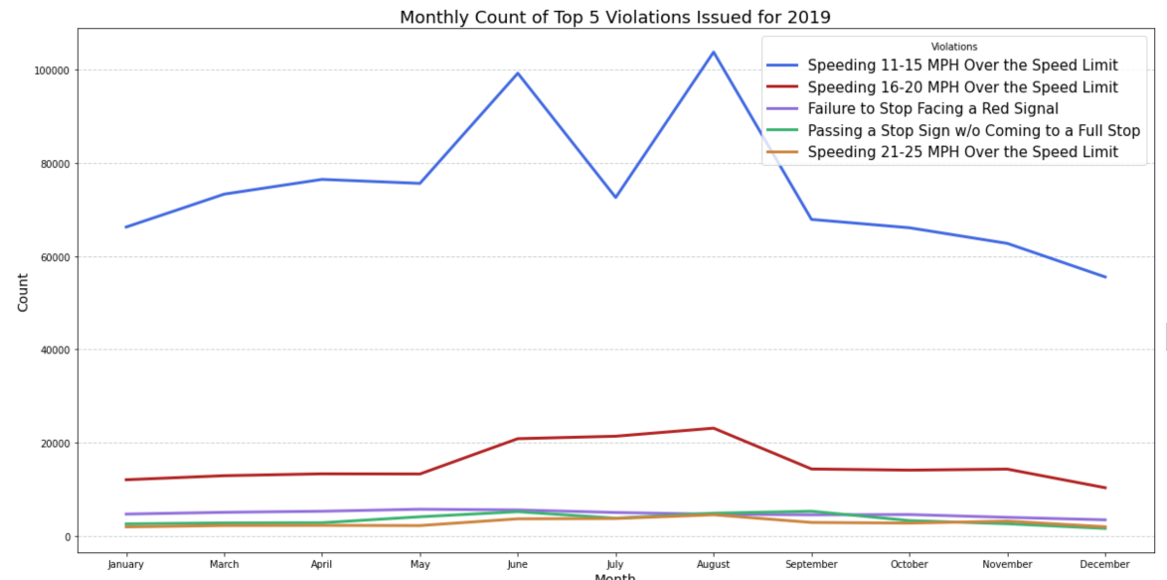
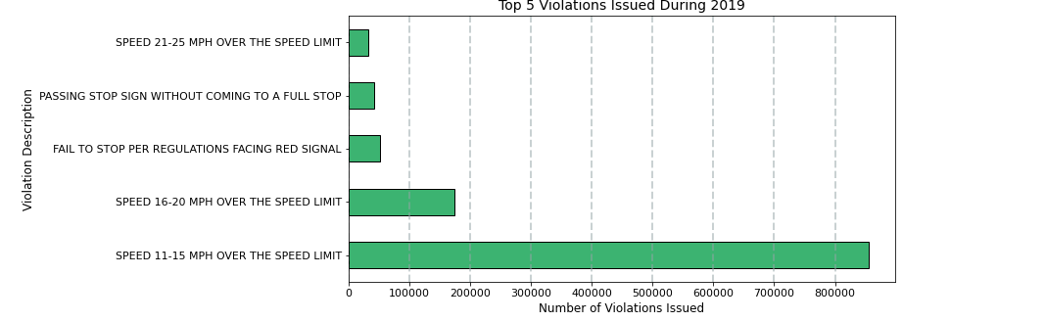
MOST COMMON VIOLATIONS
Notes:
Top 5 most common violations: *** INCLUDE NUMBERS
Speeding 11-15 MPH over speed limit (855,746)
Speeding 16-20 MPH over speed limit (174,837)
Failure to stop at red light (52,340)
Passing a stop sign without coming to a full stop (42,349)
Speeding 21-25 MPH over the speed limit (32,925)

Slide 7
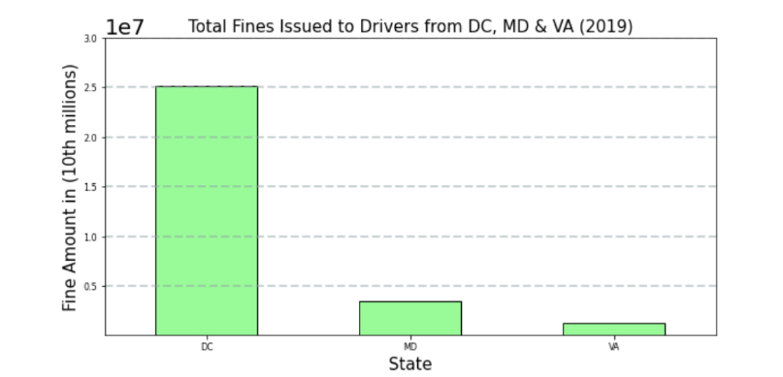
FINES ISSUED
$25,105,850
$2,502,470
$1,287,157
Notes:
*These are just fines issued in 10s of millions

Slide 8
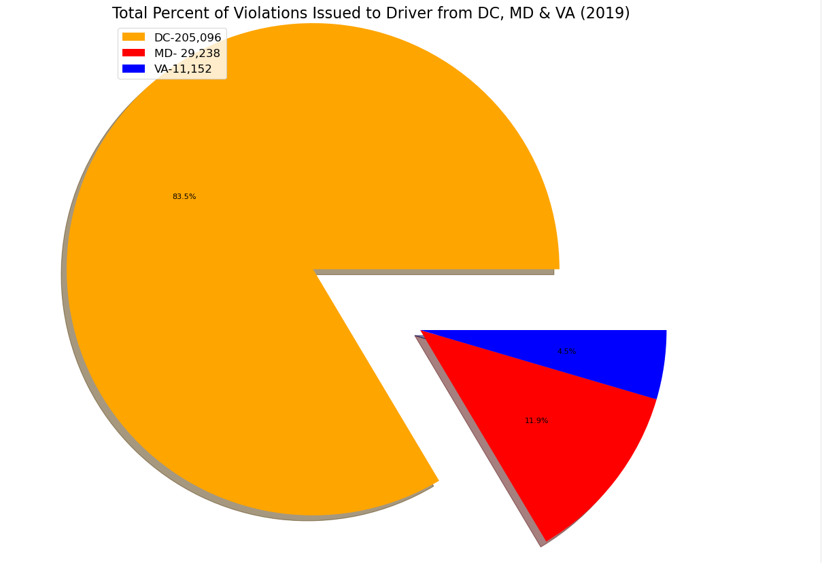
VIOLATIONS BY DRIVER STATE
Notes:
We pulled this data from the original full data set, which is specifically those licensed in DC, MD, VA.
DC licensed drivers had the most violations – 205, 096, which accounted for 84% of the violations

Slide 9
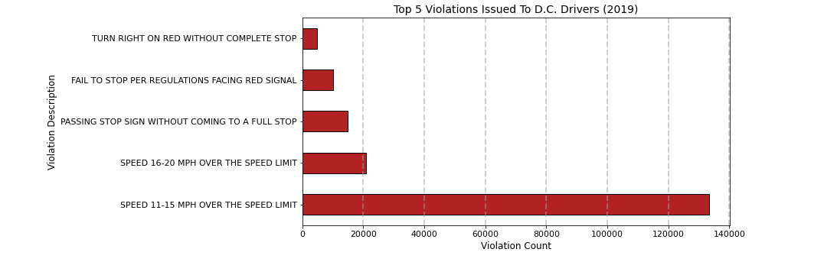
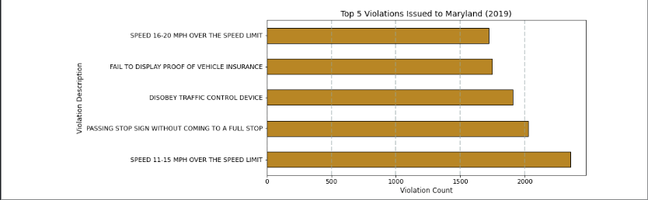
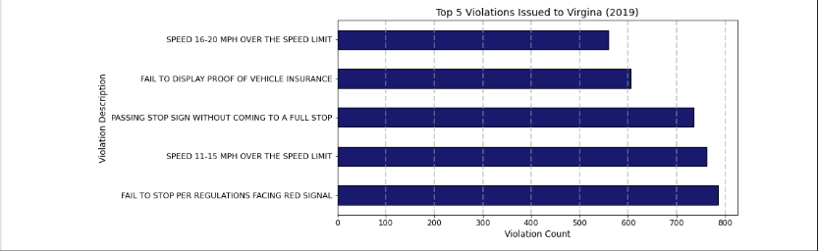
VIOLATION TYPE BY DRIVER STATE
Notes:
Top 5 Violations in:
D.C.: (RED)
Speed 11-15 MPH over speed limit
Speed 16-20 MPH over speed limit
Passing stop sign without coming to a full stop
Fail to stop per regulations facing red signal
Turn right on red without complete stop
Maryland (Gold):
Speed 11-15 MPH over speed limit
Passing stop sign without coming to a full stop
Disobey traffic control device
Fail to display proof of vehicle insurance
Speed 16-20 MPH over the speed limit
Virginia (Dark Blue):
Fail to stop per regulations facing red signal
Speed 11-15 mph over the speed limit
Passing stop sign without coming to a full stop
Fail to display proof of vehicle insurance
Speed 16-20 mph over the speed limit

Slide 10
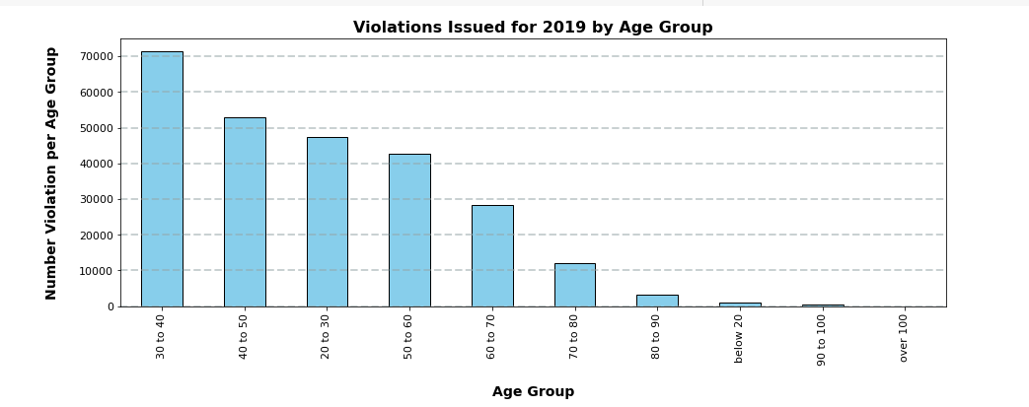
VIOLATIONS BY AGE
Notes:
People in their 30s – 40s, so people born in the 1980s, had the highest number of violations issued by a significant amount
One person with a birthdate of 1903;

